Slide 1
Introduction to Statistics and Data Representation
So why do we need all these numbers

Slide 2
Introduction to Statistics
Data Analysis or The art of getting information from data

Slide 3

Introduction to Statistics
To make large amounts of data easy to understand. We do this through the the use of statistics.

Slide 4
Introduction to Statistics
There are two categories of Statistics; Descriptive and Inferential.

Slide 5

Introduction to Statistics
Descriptive statistics
Descriptive statistics summarize population data numerically or graphically by deriving data from a sample.

Slide 6
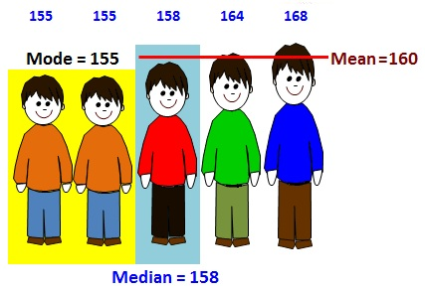
Introduction to Statistics
Descriptive statistics
Statistics pertaining to central tendency such as the mean, median, or mode

Slide 7
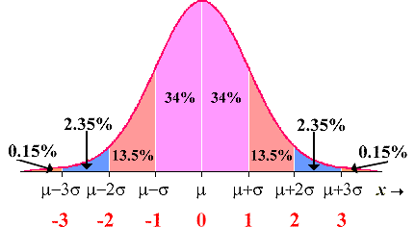
Introduction to Statistics
Descriptive statistics
Statistics pertaining to dispersion around the central tendency such as the range or standard deviation

Slide 8

Introduction to Statistics
Descriptive statistics
Statistics or graphs depicting the shape of a distribution

Slide 9
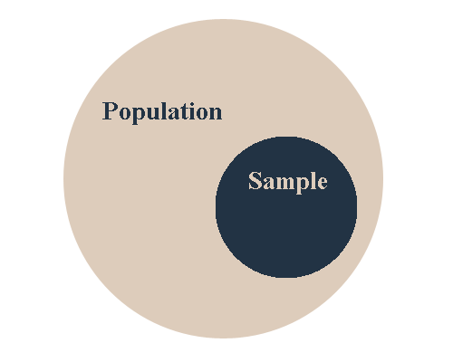
Introduction to Statistics
Inferential statistics
Inferential statistics allow one to infer population parameters based upon sample statistics and to model relationships within the data. The categories of inferential statistics are ;

Slide 10

Introduction to Statistics
Inferential statistics
Estimation is the group of statistics which allow for the estimation about population values based upon sample data. The two types of statistics in this category are population parameter estimates and confidence intervals.

Slide 11
Introduction to Statistics
Inferential statistics
Modeling allows us to develop mathematical equations which describe the interrelationships between two or more variables.

Slide 12
Introduction to Statistics
Inferential statistics
Hypothesis testing allows us to test whether a particular hypothesis we have developed is supported by a systematic analysis of the data

Slide 13
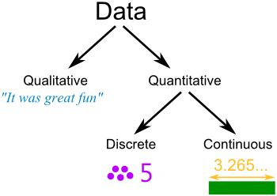
Introduction to Statistics
Types of Data
Data can be classified as either numerical (quantitative) or categorical (qualitative).

Slide 14

Introduction to Statistics
Types of Data
Numerical data can be divided into two categories; discrete and continuous.

Slide 15
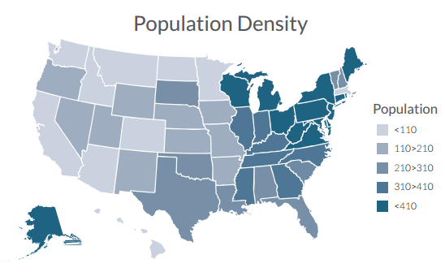
Introduction to Statistics
Types of Data
Categorical data is data that can be sorted according to a category and each value is from a set of non-overlapping values. Examples of categorical data would include eye color (green, brown, blue, etc.) and managerial level (supervisor, mid-level, executive).

Slide 16
Introduction to Statistics
Types of Data
Categorical variables are typically measured on a nominal scale. Nominal level variables are those that can simply be grouped; there’s no underlying numeric order to them and any ordering is arbitrary or artificial.

Slide 17
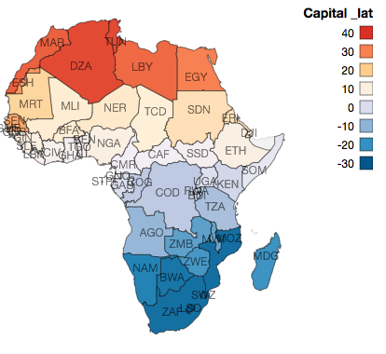
Introduction to Statistics
Types of Data
Our examples above of eye color and managerial level are both measured at a nominal level. Other examples of categorical data that’s measured on a nominal scale include type of industry, state of residence, marital status, and favorite food.

Slide 18
Introduction to Statistics
Types of Data
Please note that you might have responses “dummy-coded” with numbers to represent a response such as 0s representing male and 1s representing female, but even though there are numbers it’s still a nominal scale because the ordering is completely arbitrary; we could have had 0s representing female and 1s representing male.

Slide 19
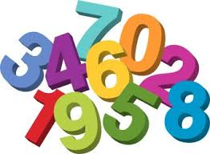
Introduction to Statistics
Types of Data
Numerical data is data that is on a numerical scale of some sort.

Slide 20
Introduction to Statistics
Types of Data
Discrete data is typically when there’s a limited number of response values and not an infinite number of response values. For example responses on a five-point scale can be any of the five values but cannot be 3.1 or 3.6 or 4.2, etc.

Slide 21
Introduction to Statistics
Types of Data
Continuous data is when the response can take on any value within the range of variable. For example responses to the question of “what’s your GPA on a 4.0 scale?” could take on not just 1, 2, 3, or 4 but also 3.17, 3.83, 2.94, etc.

Slide 22
Introduction to Statistics
Types of Data
Numerical data is measured on an ordinal, interval, or ratio scale.

Slide 23
Introduction to Statistics
Types of Data
An ordinal scale is a measure where higher numbers do represent more of a characteristic than a lower level number but the distance between adjacent response choices may not be equal and there’s no fixed zero.

Slide 24
Introduction to Statistics
Types of Data
An interval scale, like an ordinal scale, is where higher numbers represent more or a greater amount of the phenomena being measured, and where the distance between adjacent response choices are equal but there’s still no fixed and non-arbitrary zero.

Slide 25
Introduction to Statistics
Types of Data
Temperature, in Celsius or Fahrenheit, is the typical example of an interval scale in which the distance between 5 and 6 is the same as the distance between -22 and -21 and is the same as the distance between 102 and 103. But, it doesn’t make sense to say that 50 is twice as hot as 25 because 0 degrees, for both scales, is arbitrary.

Slide 26
Introduction to Statistics
Types of Data
A ratio scale has the same properties as an interval scale, except that there is a true zero and calculating ratios makes sense. For example, to say that someone has twice the income of another person is correct, at least mathematically. Sales for a particular retailer can be compared with ratios or percentages from same time last year, etc.

Slide 27
Introduction to Statistics
Types of Data

Slide 28
Introduction to Statistics
Types of Data

Slide 29
Introduction to Statistics
Standard score:
The standard score represents the number of standard deviations above or below the mean.
Distribution
Distribution of a data set or population is a listing or function showing all the possible values of the sample and how often they occur.

Slide 30
Introduction to Statistics
A normal distribution is based on a numerical data that is continuous, its possible values lie on the entire real number line. About 68% of the values are centered around the mean. The mean is directly in the center of the normal distribution.

Slide 31
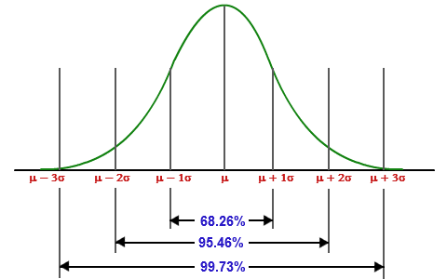
Introduction to Statistics
A normal distribution can
be seen as a bell shaped
curve.

Slide 32
Introduction to Statistics
Z Scores
If a data set is said to have a normal distribution and you standardize all the data, those scores are called z-values. Those z-values have standard normal distribution or a z-distribution.
This is useful for examining the data and determining statistics like percentiles.

Slide 33
Introduction to Statistics
Margin of Error
When data in gathered from a sample of the population not the entire population errors are likely to occur. This error is in a sense a sampling error. The margin of error is a measure of that error, it measures the maximum amount that the sample results are expected to differ.

Slide 34
Introduction to Statistics
Margin of error
Take a random sample from your population NZ (1000 people), then find the corresponding statistic from that sample. Because you know that if got another sample the statistics may vary you need to “plus or minus something” to your result.

Slide 35

Introduction to Statistics
Margin of error
That plus or minus that add to your result to estimate the parameter is called the margin of error.

Slide 36
Introduction to Statistics
Confidence Interval
One of the biggest uses of statistics is to estimate a population parameter using a simple statistic.
For example: the average household income in New Zealand (population = all NZ households; parameter= average household income).

Slide 37

Introduction to Statistics
Confidence Level
It’s not possible to find these parameters exactly; as they are based on an estimate of a sample.

Slide 38
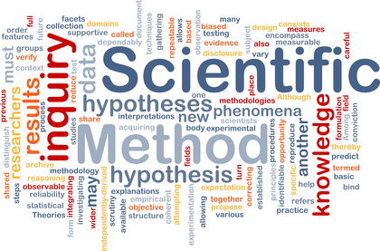
Introduction to Statistics
Hypothesis Testing
Is a statistical procedure is which the data collected from a sample and measured against a claim about a population parameter.

Slide 39
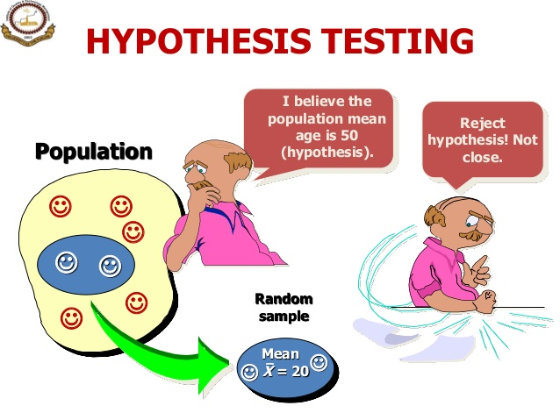
Introduction to Statistics

Slide 40

Introduction to Statistics
Hypothesis Testing
Because a decision is based on a sample and not the entire population a hypothesis test can lead you to the wrong conclusion.

Slide 41
Introduction to Statistics
Hypothesis Testing
There are a variety of hypothesis test done in scientific research, including t-test(comparing two population means), paired t-test( looking at before/after data).

Slide 42
Introduction to Statistics
P-Values
Hypothesis tests are used to test the validity of the claim that is made about a population. The claim is on trial you are said to be testing the null hypothesis.

Slide 43
Introduction to Statistics
P-Value
All Hypothesis tests ultimately use p-value to weigh the strength of the evidence(what the data is telling you about the population).
Small p-value (typically ≤ 0.05) indicates strong evidence against the null hypothesis so you reject it.
Large p-value (typically > 0.05) indicates weak evidence against the null hypothesis, so you fail to reject it.
P-values very close to the cutoff (0.05) are considered marginal .

Slide 44
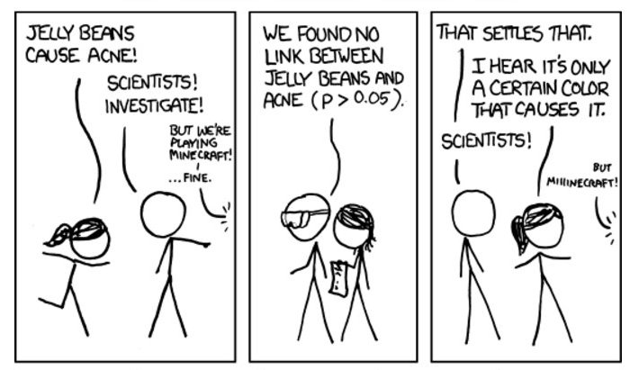
Introduction to Statistics
P-Values

Slide 45
Introduction to Statistics
Healthy Skepticism:
The reality about statistics and research in general is that we need treat the results from studies with a dose a healthy skepticism. In fact about what we read and hear.

Slide 46

Introduction to Statistics
Healthy Skepticism:

Slide 47
Introduction to Statistics
Healthy Skepticism:
It not a case of “I can’t believe anything any more” , but “ I wonder where the numbers or data came from.”

Slide 48
Introduction to Statistics
Healthy Skepticism:
Research and Statistics can go wrong for many reasons.
- a simple error may occur.
- For what ever reason the results get tweaked or more commonly exaggerated either the data or the way they are represented.
- By error of omission – information or data is left out.
- Fabrication of data.

Slide 49

Introduction to Statistics
Healthy Skepticism:
- The way a question is worded can give misleading results. This could give a biased result. Research has shown that even small changes in wording affects the survey outcomes.

Slide 50

Introduction to Statistics
The reality is where research is concerned that you need a healthy skepticism because unfortunately there is research out there that is meaningless.

Slide 51

Introduction to Statistics

